Slide 1


Slide 2
Ethos
Returning Officers

Slide 3


Ethos
the distinguishing character, sentiment, moral nature, or guiding beliefs of a person, group, or institution
Notes:
Merriam Webster Dictionary definition. Tell the group that the point of this series of sessions is to create clarity for them about their purpose as SU officers.

Slide 4
Members of your Ethos Crew
Ethos Tutor:
Person 1
Person 2
Person 3
Person 4
Person 5
Person 6
Person 7
Person 8
Person 9
Person 10
Notes:
Please add the names into your slide as soon as you can. They can be added before the session if possible.
If someone joins your group that you weren’t expecting, interrogate them. If they have a good reason to change groups that’s OK, but let the other trainers know via WhatsApp

Slide 5
What do we want to get from SUT?
Notes:
On a flipchart blue tacked to the wall, take a list of people’s expectations and hopes for the event

Slide 6
The T-Shirt of our True Identity
Resource
Needed
Get a T-shirt Page
In each quadrant, draw:
What do you most want to change in your SU?
What’s the biggest likely challenge to success?
Your proudest achievement in life so far?
Something nobody here knows?
20 mins
Notes:
There will be 20 t-shirt templates in your box.

Slide 7


Name

Slide 8
Our House
We need to set some house rules so that everyone can:
Understand what’s expected of each other in the training environment
Feel free to express themselves safely and respectfully
Be actively included in an accessible group
Come to understand that we’re not the same and difference is our strength
Notes:
These are the non-negotiable ground rules. Please lead them into including ‘Be on time’ and ‘attend every session’. Do your best!

Slide 9
Our House Rules

Slide 10
Why have we changed SUT?
Ethos? Why Ethos?

Slide 11
Ethos worked well last year
We want to develop a sense of continuous development
We want to bring more of your thinking and doing into the work
We want the returners’ sessions to more closely map the beginners’ sessions, so you get an advanced version of their ethos knowledge
Our sense is that people retained more information last year than previously

Slide 12
10 Hours’ Contact Time
Over the next 4 days:
  We’ll think about what an SU is for
  We’ll talk about what roadblocks we found as officers
  We’ll talk about ourselves as members of a team
  We’ll think about how our teams exist and function
  We’ll consider the qualities of leadership you now need
  We’ll talk about ethics
  We’ll consider how best to campaign
  We’ll consider self care
  We’ll discuss the priorities of the SU

Slide 13

What is the point of the SU?
Learning objectives
You will:
Consider the nature of the Students’ Union
Explore the fact that each SU experience is different
Be clear on the difference between ‘activity’ and ‘purpose’
Consider our role as officers
Notes:
You may wish to touch on a preliminary ‘activity vs purpose’ point.

Slide 14
What is your Students’ Union?
Split into three groups
For 2 minutes consider an answer to the following question:
“My Students’ Union is…”
Don’t overthink it!
Notes:
Give them 5 minutes deliberation, 5 minutes shoutout feedback max.
Write it up on some flipchart. Tack it to a wall.

Slide 15
What should your Students’ Union be?
Split into three groups
For 5 minutes consider an answer to the following question:
“My Students’ Union should be…”
Don’t overthink it!
Notes:
Give them 5 minutes deliberation, 5 minutes shoutout feedback max.
Write it up on some flipchart. Tack it to a wall.

Slide 16
So what is the purpose of our SU?
1. to represent students faithfully at every meeting on every committee ensuring that every voice is heard?
2. to provide advice and support services for students in need?
3. to provide services for the students like a book shop and a high end coffee bar?
4. to provide gigs and nights out for the students to promote the craic?
Notes:
Provide a space for your crew to consider each of these and perhaps suggest more if they’re well animated. Point out that none of these things is the be-all and end-all for the SU. Hint at the possibility that none of these is the final purpose.

Slide 17
Note the differences
Even if you’re really proud of your SU, you know it could be better.
You’ve had time so you know the ways it could be made closer to the ideal.
Most people find it difficult to deliver on abstract ideas, but we should still be guided by the point

Slide 18
What’s the point?
The central purpose of the Students’ Union is to secure educational and social change in the interests of its students.
Notes:
Trainees may baulk at this. You should explain that all the other activities of the SU are services you provide to establish the SU as the friend and legitimate representative of the students, but that when push comes to shove, the whole objective of the SU is to secure change. The Next slide will reinforce this.

Slide 19
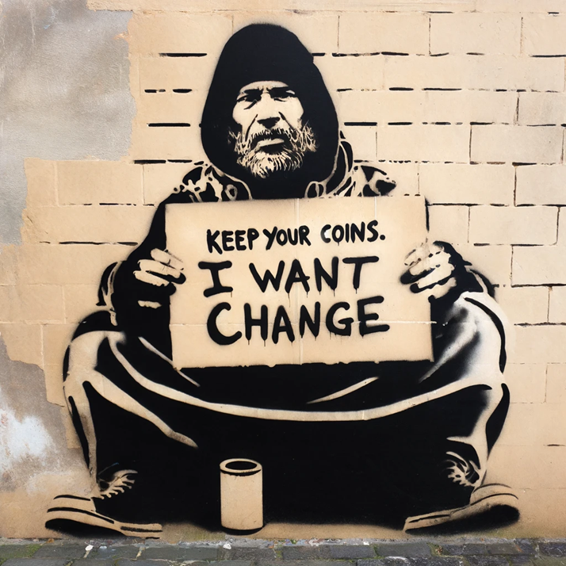
Change is The Point
The things that are already great don’t need your attention
The things that need to change to improve the lives and prospects of your members need urgent attention
Student Poverty, Housing, Discrimination, Unfair Campus Practices, and the Shrinking Autonomy of the SU all require our strongest collective efforts
Notes:
Explain that there will be other issues on campus and across education which emerge as the biggest changes needed. Explain that some of these issues are constants in the life of our movement.
If it’s hard to read the picture, it reads ‘Keep you coins, I want change”

Slide 20
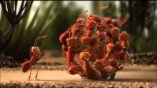
Unity is strength
Notes:
Three nice videos. I didn’t have the heart to cut it. They make exactly the same point. They’re also good crack.

Slide 21

Who is the union?
Does your SU have a picture on the website with the sabbatical officers and the words ‘Meet your students’ union’?
Whomever put that photo up is missing the point.
The Students’ Union is the students themselves; you’re just there to organize and lead them
Don’t let yourself fall into the trap of seeing yourself as the union.
MEET YOUR UNION
Notes:
Ask your officers to whip out their phones and check their own SU website.
Explain that the risk of a personalized hero worship SU is that it relies on personalities who will turn over every year and will create fluxes in the activities of the Union. By being broader based and recognizing SUs are about the members, more continuity and involvement is free to occur. Besides – if the student isn’t YOU, where do they fit in?

Slide 22

An SU officer has many hats
Break into 4 Groups and consider for 5 minutes the role of a student officer as
Activist
Governor / Administrator
Portfolio Holder (Ed, Wel etc.)
Representative
What have you been this past year?
Notes:
Make it clear that each successful officer owns all these hats and has to be prepared to swap them according to the job to be done. The skillsets are different but they’re equally important. Some people have strengths in some areas and are weaker in other areas – that’s absolutely fine.

Slide 23

Tensions between needs
Not everyone will understand the many roles you are expected to fill as an SU officer
Sometimes the role of ‘activist’ comes into tension with the role of the ‘governor’
Often, the role of representative comes into conflict with the role of ‘governor’
The need to make meaningful progress in your portfolio can often come at the expense of time on activism.
How can we balance these things?
Notes:
Allow a conversation about those conflicts. Next slide will have some tensions illustrated.

Slide 24
Union / Union
The teachers’ union at your college has called a marking strike.
They’re arguing for better pay and conditions; they haven’t had a pay rise in 4 years
A group of students has come to you and demanded you publicly oppose the teachers’ union and denounce them
What should you do?
Would you approach it differently knowing what you know?
Notes:
Allow this to run a little. Explain that “The student movement has recognised the decisions of the Trades Union movement, so long as processes to ensure the voices of the union members have been heard.”
The traditional USI line is that every group in society has a right to seek vindication for their interests. By supporting the existence of a space for the trades union movement to express their concerns and causes, our right to do the same is preserved.

Slide 25
Tensions are normal and valuable
If there were no tensions, there would be no decisions to take.
Let’s think about tensions that existed for you last year
Notes:
Point out that every year is different, but that most of the issues which occur in student life can be understood with reference to problems in the past. The other officers in their position around the country and the other officers in their Union can help them figure these tensions out.

Slide 26
Team Development
“The way a team plays as a whole determines its success. You may have the greatest bunch of individual stars in the world, but if they don’t play together, the club won’t be worth a dime.”
Babe Ruth – Baseball Legend

Slide 27
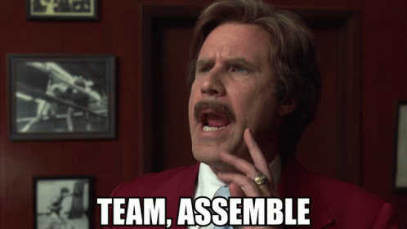
Team Development🗣️👂🤗🤬
In this session we will consider:
What makes a successful team?
What motivations exist within your team?
How is your team shaping up?
Recap on Tuckman’s Theory of Team Develoment

Slide 28
Team Communication Exercise
Resource
Needed
All good teamwork is a mix of communicating and doing
The next two exercises are designed to develop the need to think, prioritise, listen and speak
Tutor: Split group into two teams
Tutor: Give one group the instruction sheet, give the other group the plasticine.
3 minutes of deliberation
7 minutes of communication and making for each item
GO!
Notes:
Exercise 1: Give them the Plasticine and Instruction Sheet 1

Slide 29
What was the point of the exercise?
Communication is a two way process
Before we communicate an idea we should be sure to think about it and be clear in our mind how it works
We don’t always have all the information
We don’t always have the resources
When we combine the information, the resources and good communication, we can get things done.

Slide 30
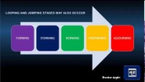
Building a team: Tuckman’s Theory

Slide 31
Was this real for you last year?
The Tuckman Model is deliberately vague but useful
Your role this year is to get past Storming ASAP
You know you can’t force it:
  Let’s think of ways we can make it cleaner

Slide 32
Getting to Norming & Performing Fast
There’s no magic potion to avoid the Storming phase
Keep communication open, positive and straightforward
When disagreements break out, accept there’s a communication challenge and seek to answer it. Sometimes the President may need to adjudicate and take a decision.
All disagreements are an opportunity to communicate
Keep an eye out for exclusion or bullying
Notes:
Explain that, whether they like it or not, this analysis satisfies for almost all teams. They will be excited at the start, they will have rows as they push the envelope, they will begin to get up to speed, they will then be excellent – and then it’s time to adjourn.
Point out that they may form many smaller teams and that by understanding this dynamic, they will be able to recognise the STORMING and not get bent out of shape over it.

Slide 33

Understand…
Teams are complex
Most people would rather work alone, given the chance, but…
…surrendering a little ego to work with a team of committed people and use their brains and capacity for work is usually worth it
Team communication is a multiway process
Notes:
Explain that sometimes communication needs to be one-on-one and sometimes it can be helpful to engage the whole team. But keeping the whole team aware of what’s going on is vital to ensuring everyone feels included and everyone can feel empowered to offer their best.

Slide 34
Needs of the Portfolio vs Team
Are you a team player?
What parts of your work are you prepared to sacrifice for the team?
Can you do better this year than last year?
Is it ‘my way or the highway’?
Are you a person who DOES or someone who thinks your time is more valuable than others’?

Slide 35
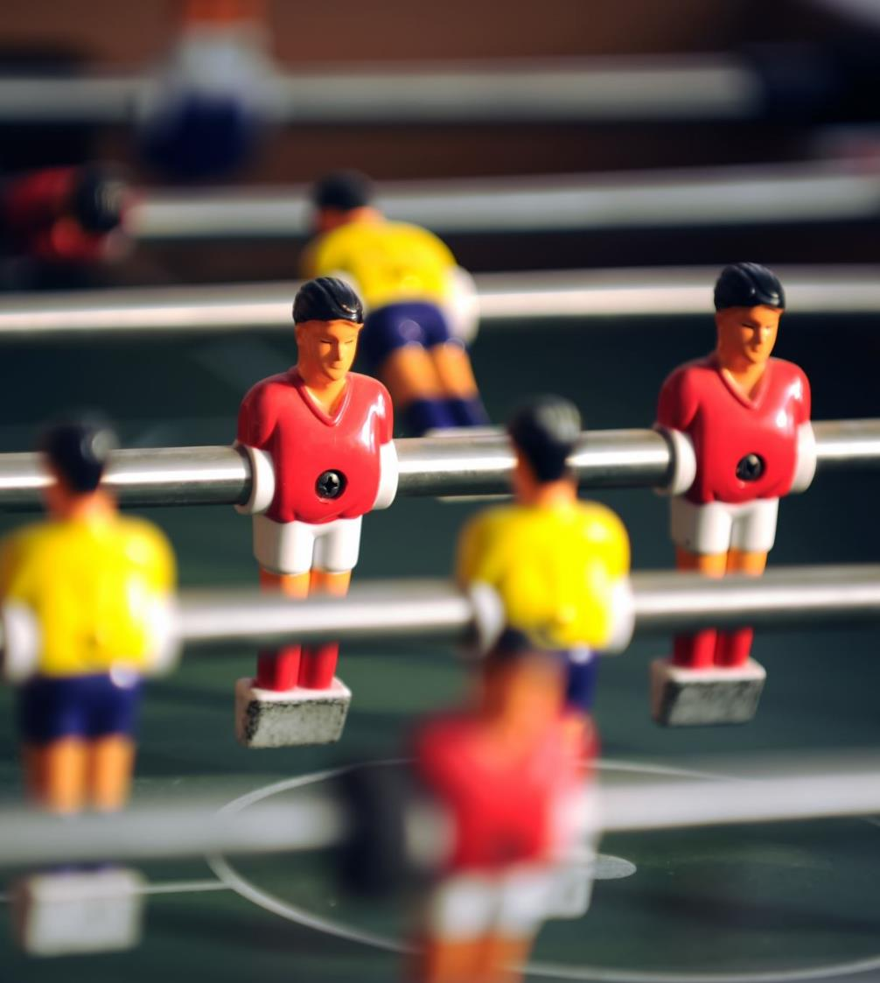
Cliques are not as good as teams
Cliques tend to be groups of like-minded people from similar backgrounds with similar experience
Teams form when people with a similar goal in mind share their skillsets with one another
11 goalkeepers together = a clique – useless football team
1 goalkeeper, 3 forwards, 3 midfielders, 4 backs – that’s a team.
You’re a member of a clique right now. How do you escape it?

Slide 36
A long way to go
“We got a long way to go, a short time to get there… we gonna do what they say can’t be done.”
C.W. McCall “Convoy”

Slide 37
How long have we in office?
Your Tutor is about to blow your mind and scare the pants off you.
In preparation, please now take the time to secure your pants.

Slide 38
Actual contact days with students
78
Make them Count!
Notes:
Explain the following:
Elected in March
Start the Job in June or July
So, 8 months until the election to replace you.
Students begin in Sept/Oct
10 weeks contact time, but it’s much harder in the last two weeks because of assignment pressure
Then Xmas
Immediately after Xmas have to decide if you’re running again
6 weeks contact time then elections
Then 2/3 weeks contact time then Congress
Then no more students.
365 days in the year
But 2/7ths of those are weekends = 255 days
Minus 9 bank holidays = 246 days
Minus 20 days annual leave = 226 days
Minus days where students are not on campus = 110 days.
8 National Councils per year
4 days at USI Congress
7 days at USI training…
When we consider all of these variable dates, we arrive at: 78 days of unrestricted on-campus contact days with students.

Slide 39
Actual working days without students
139
Make them Count!
Notes:
Explain that this is an average, and there may be a few days more or fewer.
These are days to be preparing, developing relationships and strengthening your union for the future and whomever comes after you.

Slide 40
139 days to prepare for 78 days’ contact time
There are so many things to plan for
  Fresher’s Week
  SHAG Week
  RAG Week
  Seachtain na Gaeilge
  Mental Health Work
  College Awareness
  Many Many More
A lead officer on each event
Each officer needs to be able to drop some work to support the team effort
If you’re sensible, you will engage PTOs and Class Reps to support the whole effort
You need to make the staff aware of your plans ASAP

Slide 41
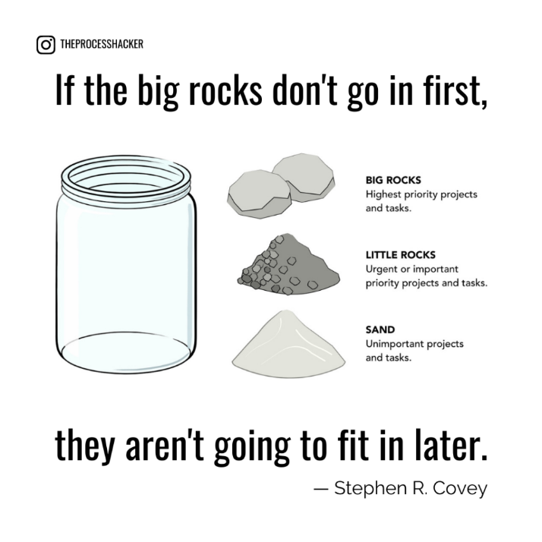
And then there’s life…
Your family, friends, relationships, health – they’re big rocks
The little stones – they’re urgent and important and need to get done
The unimportant tasks are like sand.
Get the big rocks in the jar first – the sand isn’t important
Notes:
A google search for Stephen Covey ‘big rocks’ gives an excellent video, if you have 8 minutes of your life you don’t want to get back.
Explain that if we fill the jar with the sand of unimportant tasks – the ‘busy work’ there will be no time or space for the big rocks. Major projects need major attention and need to be prioritised. Get them in the jar first, then the little rocks, then get (preferably as little as possible) sand in there.

Slide 42

Your self-care matters
Sabbatical Burnout happens when the big rocks aren’t taken care of first
Your health, including your mental wellbeing, is a true possession and crucial to who you are
You need to take breaks to remind yourself of your own needs
Only you can put yourself first.
If you feel yourself being overwhelmed, reach out for support
Use the START manual.
Notes:
The START manual will be given to all trainees. It’s a self-guided self-care workbook designed to help officers build resilience and seek support. It was developed by USI through the National Office for Suicide Prevention.

Slide 43
Leadership
"Action springs not from thought, but from a readiness for responsibility."
Dietrich Bonhoeffer – Anti-Nazi and Faith Leader

Slide 44
What is leadership?
You’ve been an officer before.
Now you’re a senior officer, or even a President.
It’s your job to lead now.
How did your ‘leader’ manage last year?
Notes:
A bit of an opportunity to vent and reflect on bad practice or good practice. They’re seeking reassurance.

Slide 45
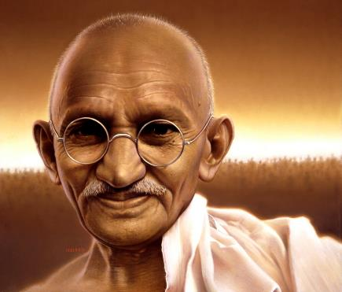
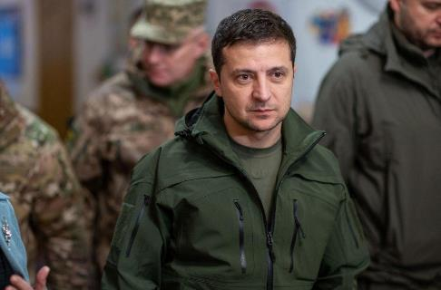
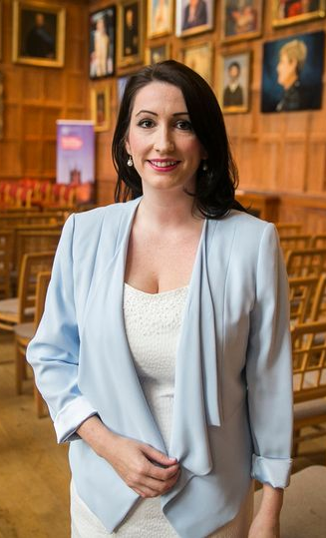
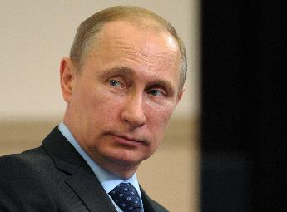

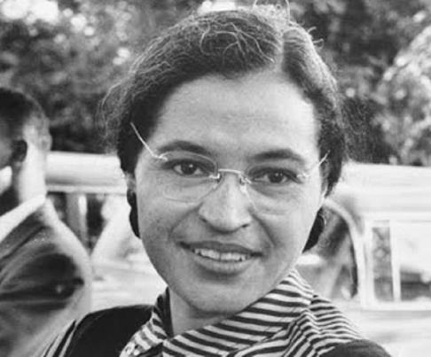
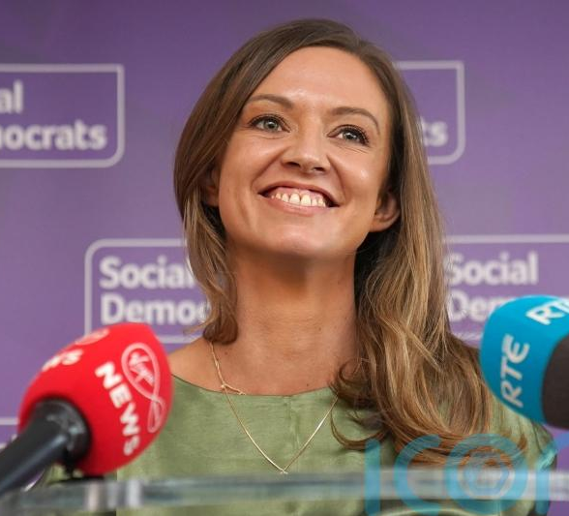
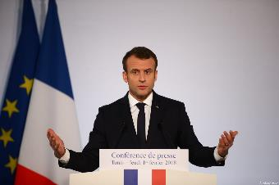
This Photo by Unknown Author is licensed under CC BY-SA-NC
Notes:
Ask members of your group to discuss these leaders, or to suggest others. If you’re unsure of the leaders, consider having Wikipedia open for it.
The point isn’t knowledge, it’s that leadership comes from many sources, isn’t always elected and has many aspects. Speak to this if you wish, but make the point that every person in this slide has people who think they’re awesome and people who think they’re the literal worst.
Mahatma Gandhi, Nationalist revolutionary leader of India
Volodymir Zelenskyy, President of Ukraine
Emma Little Pengelly MLA, DUP Deputy First Minister of Northern Ireland
Vladimir Putin, President of Russia
Donald Trump, former President of the United States of ‘Murica
President Macron of France
Rosa Parks Civil Rights leader USA
Holly Cairns TD, Leader of the Social Democrats in Ireland
The thing to get from this is that lots of leaders follow lots of guiding principles. We strive to be one over the other. We recognise that everyone on this page is a leader – we don’t want to emulate all of them. We don’t have to love them

Slide 46
Many theories of leadership
We can’t set your leadership style, but…
The most critical skills for ethical effective leadership are essentially human skills
We consider ‘Relational Leadership’ to be an effective way to manage a dynamic team.
It’s a big theory, but we can summarise it.
Notes:
HAND OUT THE FIDGET TOYS AND SWEETIES

Slide 47
Relational Leadership: Inclusivity
Foster a sense of belonging in the team
Value diverse points of view, especially if they’re challenging
Respecting the minds in the room
Every member of the group is valuable
RLM
Inclusive
Empowering
Process Oriented
Purposeful
Ethical
Accountable
Notes:
The pretext here is “A good leader tries to…”
Ask the group if they honestly respect viewpoints which differ from theirs
Speak to the need to ensure that those who perhaps feel not part of the clique or are experiencing imposter syndrome are able to contribute.

Slide 48
Relational Leadership: Empowering
Trust your team to work independently
Trust your team to ask for help when needed
Delegate in a way that shows confidence in the team
Don’t miocromanage
Encourage the team to make good decisions and consider how the decision making affects the whole organisation
RLM
Inclusive
Empowering
Process Oriented
Purposeful
Ethical
Accountable
Notes:
The pretext here is “A good leader tries to…”
Explain that micromanagement will instil a sense in the team member that you don’t trust them.
Explain that major activities require delegation, and that when difficult decisions have to be made, if people consider the needs of the whole organisation, they can usually be trusted to make good decisions.

Slide 49
Relational Leadership : Process Orientation
Agrees performance goals with the team
Agrees how the team will work together
Upholds the rules in place to ensure others do, too
Flexibility within the processes
RLM
Inclusive
Empowering
Process Oriented
Purposeful
Ethical
Accountable
Notes:
There is a way to get things done, and this leadership style emphasises that everyone must stick to some guidelines so that outcomes can be predictable all the time. This reduces management time, because if everyone knows what to do and how to do it, they can take personal responsibility.
This is not the same as slavish reliance on existing process. You may need to change the rules – but for everyone, with them made fully aware of the changes.

Slide 50
Relational Leadership : Purposeful
Leaders align their decisions with their personal sense of purpose
Make their sense of purpose obvious to team members so important decisions are clear and predictable
Agrees a common ground and common goals
RLM
Inclusive
Empowering
Process Oriented
Purposeful
Ethical
Accountable
Notes:
You’re all trying to achieve something. We share our goals, we pursue them together.

Slide 51
Relational Leadership : Ethical
Strong relationships stand on a foundation of trust
Team effectiveness flourishes in a fair environment
Honesty, integrity and humility
Adheres to high standards and expects others to do the same
RLM
Inclusive
Empowering
Process Oriented
Purposeful
Ethical
Accountable
Notes:
On ‘Ethical’

Slide 52
Relational Leadership : Accountable
Nobody has anything to fear from accountability
When we fail to meet our objective, we analyse why and refine our plan
By being open and honest we receive respect and trust
RLM
Inclusive
Empowering
Process Oriented
Purposeful
Ethical
Accountable

Slide 53
The Nolan Principles
Selflessness should take decisions solely in terms of the student interest. They should not do so in order to gain financial or other material benefits for themselves, their family, or their friends.
Integrity should not place themselves under any financial or other obligation to outside individuals or organisations that might influence them in the performance of their duties.
Objectivity In carrying out SU business, including making appointments, awarding contracts, or recommending individuals for rewards and benefits, you must make choices on merit.
Accountability you are accountable for their decisions and actions to your members and must submit themselves to whatever scrutiny is appropriate.
Openness should be as open as possible about all the decisions and actions that they take. They should give reasons for their decisions and restrict information only when the wider student interest clearly demands.
Honesty a duty to declare any private interests relating to their duties and to take steps to resolve any conflicts arising in a way that protects SU interest.
Leadership you should promote and support these principles by leadership and example.
Notes:
The Nolan Principles are standards for people in public life. They emerged from investigations into corruption and sleaze in the early 1990s in the UK. They are applied to members of governing bodies of entities in NI and Ireland and are good bases for ethical SU leadership

Slide 54
A strong foundation for a strong team
RLM
Inclusive
Empowering
Process Oriented
Purposeful
Ethical
Accountable
It’s not enough for the president to be all these things
Each member of the team must commit to ethical leadership of their union. You may need to force them to commit.
Each member of the team must commit to a high standard of engagement
Big decisions flow from your personal commitment to your values

Slide 55
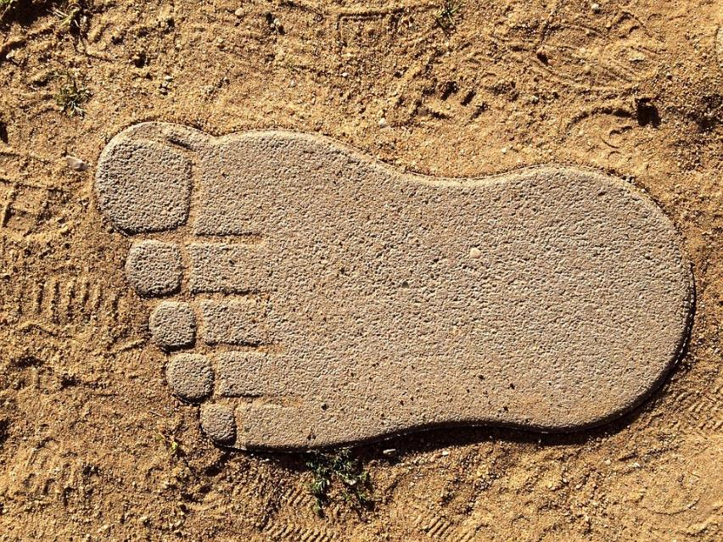
Standing by your values
Resource
Needed
Get a sheet of flipchart paper
Stand on it
Draw the outline of your feet
  This may be a time for some teamwork!
Inside your footprints write up five of your values per foot.
Take no more than 10 mins
Notes:
When they’re done, put them up on the wall. Come back to them frequently.

Slide 56
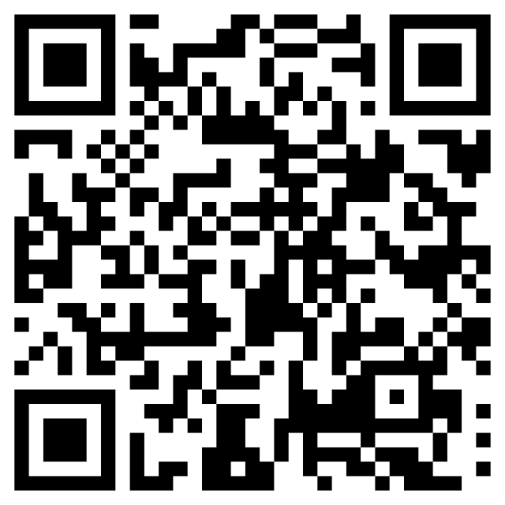
QR code for more on Relational Leadership

Slide 57
Achieving Change
Coherent Campaigning in Students’ Unions
Notes:
We need to recap this, but if people are feeling like ‘this is the same as last year’ then you may need to rattle through it and discuss actual campaigns they’ve run.

Slide 58
What is a campaign to you?
What campaigns did you run last year?
How did they go?
What method of planning did you use?
Notes:
No more than 15 mins on this. No need to write it up, but good to get people thinking.

Slide 59
What is a campaign to the SU?
A campaign is a structured and planned series of actions designed to secure a desired change
Campaigners combine actions to achieve a coherent push for change
Too often, we just do stuff and call it a campaign.
This can result in failure or worse – thinking it succeeded.
Notes:
Lead a conversation about what a campaign is, without too-quickly leading towards the difference between tasks, actions and campaigns.

Slide 60
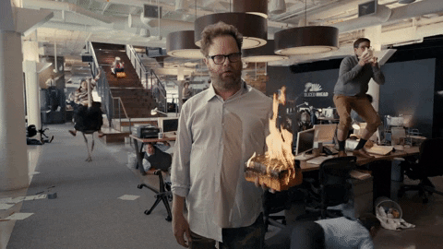
“Cracking on” achieves very little
If we proceed without a plan, we may be seen to be doing something 👍
We will waste effort and squander good will👎
We will not be able to see any progress we’ve made 😒
We’ll waste time and learn nothing 😢

Slide 61
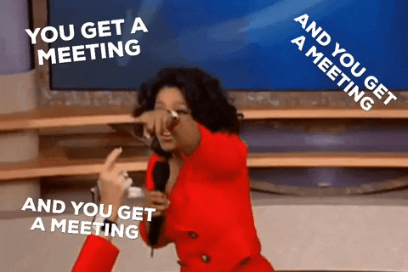
Endless meetings achieve very little
You can quickly become comfortable in an office away from students
You waste time on unimportant disputes
You don’t deliver anything
“Artists Ship.”
  Steve Jobs, CEO Apple
Notes:
Explain that meetings aren’t illegal, but they are only valuable in a framework, to achieve some aspect of change.
“Artists Ship” means ‘you have to get something done. There must be output for there to be outcomes’
Have you ever had a series of meetings that could have been an email?
THAT’S WHAT WHATSAPP AND MICROSOFT TEAMS etc ARE FOR.
You may need to explain who Oprah Winfrey is. She often had ‘one for everyone in the audience’.

Slide 62

A campaign is built from (sometimes many) individual actions
The actions are planned to achieve an impact
The impact is intended to help bring about a change
There may be many actions and many impacts towards one change
Notes:
A series of unplanned actions is not a campaign. It’s busy work, and usually a waste of time. I mean, just look at the mess this kid is making of building a castle. Shoddy. She should be ashamed of herself.

Slide 63
Not all campaigns resonate.
Your job is to find one that does.
You are more likely to achieve a resonating campaign if:
  You are close to the interests of the Students
  You understand what students think on the issue
You are also elected to lead.
  You may need to explain uncomfortable truths to your members
  You will have to ask students to take action
How do we find out what students want?

Slide 64
How do we find out what students want?
Bad news: you’ve been an officer, which means you haven’t been a student for at least a year.
What can you do to find out the views and wants of students?
Notes:
Tutor led discussion. Considering all the tools available to Sus.
Microsoft Forms?
Big survey?
Survey Monkey?
What other tools do they think they’ll use?
We want to lead them to understand that all these technologies have some use – but that the engagement of class reps as the eyes and ears of students, as well as having officers physically go out and talk to students, is what will establish what students actually want – and will result in recruiting more activists.

Slide 65
GOAT – Go Out And Talk
The number one method of finding out what people want is asking them
You were elected to lead, not read minds or make stuff up.
The major challenge facing SUs in engaging students isn’t their apathy.
It’s our lethargy and our reserve.
We need to be able to go out and talk.
Happily, there’s a specialist session!
Notes:
A specialist session on this will be delivered by Ben Kinross whether he wants to or not.

Slide 66
Getting to a theory of change

Slide 67
A theory of change: overview
To get to the change you want to see, you need to:
Know where you are now – the problem needing solved
Visualise the future where the change has been achieved
Identify the impacts which can achieve the change you need.
Plan to achieve those impacts
We can do all these things using a theory of change model
Notes:
Explain that a theory of change is a model to allow people to see how to achieve change, and to understand how and why this change will happen.

Slide 68
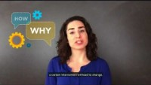
Theory of Change Basics
Resource
Needed
Notes:
Play the video. Point to the poster (which should be in your box)

Slide 69
Theory Of Change Exercise
Resource
Needed
I’m always late for work
Inconvenient bus times!
Working in Threes:
Take 2 A3 sheets
Take some sticky notes
Working from the top of the sheet:
Call out the Problem needing solved.
Dig down into the problem and its actual causes.
Keep digging, to find the root causes of the problems. There may be many.
In the next part of the exercise we’ll use our analysis to construct our theory of change
Maybe I stay up too late
I need to go to bed earlier to wake up earlier and get an earlier bus.
Notes:
Imagine you are chronically late to work. If your goal is to get to work on time, you may have identified multiple reasons for being late. If you only consider one of these reasons and don’t identify root causes, which are simply other reasons for your lateness, you will continue to be late. One reason may be traffic, but another may be leaving your house late, or not getting to bed on time.
By systematically working out what the problem is, what causes those problems, and what are the root causes of those problems, we can identify ways in which we might intervene effectively to achieve a different outcome.
The ToC is just a road map. It’s the articulation of how and why a given set of interventions will lead to specific change. It follows a generally straightforward “if/then” logic — if the intervention occurs successfully then it will lead to the desired result. Of course, behind that logic is a set of beliefs and assumptions that support our expectations about how change will occur.
In this exercise, have the trainees work in threes to pick apart a major agreed problem.

Slide 70
You’ve analysed the problem. Now we construct our theory of change
When you’re sure you’ve perfected the analysis of the problem and its root causes:
Working from the bottom of the sheet, propose workable solutions to the root causes.
Assume the solutions work, and then follow the logic, knocking down root causes and getting to actions which can cause the problems to be undone and the change to occur.
Notes:
There is a poster. It’s too detailed for the screen. It’ll be in your box.

Slide 71
A theory of change is a powerful but accessible tool
Every member of your team can easily apply this tool to all sorts of simple and complex work
You can work as a team to decide on each step and each iteration of the tool
By documenting it properly you can come back to and revise it to keep on track

Slide 72
Be aware of the ceiling of responsibility
High goals are welcome
Recognise that your leadership and your actions can bring us closer to the change you wish to see
Be honest about the things you can and cannot achieve
Be prepared to accept that some goals are above the ceiling of your responsibility and the ceiling of your organisation
You cannot move the ceiling of responsibility on your own.
Accept credit for the changes you do make.

Slide 73
Remember: Change is the point.
In this exercise we will:
Recap on the definition of a campaign
Use our knowledge of Theory of Change to plot a campaign plan
Recognise that there’s a choreography to campaigns, and that some elements of a campaign activity have to come before others

Slide 74
What needs to change?
What one change do you want to bring about during your term in office?
Notes:
On a Flipchart page, have someone scribe the things the group wants

Slide 75
How do we create change?
CAMPAIGN
Communications
Planning
Tactics
Media
Organising
INFLUENCE
Relationships
Representation
Policy Insight
ACTIVISM
Political Education
Student Engagement
Leadership Development
Research
Democracy
Notes:
Explain that the rings are interlinked, not just overlapping. The SU has roles in every part of the diagram, and because SU officers have many hats, they will be expected to be able to undertake all of these activities.

Slide 76
Unfortunately, time exists
We have a short period of time to deliver important campaign plans
Sometimes, the time of year has an impact on the success of a campaign (wouldn’t a SHAG campaign early in S1 make sense?)
There is an order to campaign operations
  You would decide a date for an action before publicising it
  You would find out the planned objective before planning an activity – wouldn’t you?
Notes:
Explain that sometimes people plan actions without getting their ‘ducks in a row’.

Slide 77
Ducks, which must be in a row
Resource
Needed
Victory Party
Put together your arguments
Plan your ‘actions’
Talk to local media
Write an effective campaign aim
Identify the decision makers
Identify solutions to the problem
Identify your allies
Thank campaigners
Identify who influences the decision maker
Communicate wins
Build a campaign team
Evaluate
Order Pizzas for Victory Party
Identify the problem
Notes:
Explain that, just as a good story has a beginning, middle and an end, a successful campaign has a natural flow from start to finish.
There’s a couple of copies of this in your box. Split the group in two, give them a pair of scissors and have them arrange the campaign chain from start to finish. Sellotape the ends together to make a big long snake. It’s a silly game but it reinforces the principles.

Slide 78
Have you ever used a Gantt Chart?
A Gantt Chart is a way to plan the order of tasks and to see how long a project will take to complete
It shows where you might undertake simultaneous actions and where you need to wait for one aspect to complete before moving to the next task
It helps keep people aware of what’s expected of them
An alternative is to use tools like Microsoft Project (expensive) or Basecamp. In USI we use Microsoft Planner (free).

Slide 79
A Gantt Chart can show lots of info!
Week 1 | Week 2 | Week 3 | Week 4 | Week 5 | Week 6 | Week 7 | Week 8 | Week 9
Research Problem
Consult with Class Reps
Design Materials
Print Production Time
Finish socials
Deploy materials
Review & Evaluate
Anna
Bryan
Charlie
Diana
Notes:
On this chart, we know Anna is responsible for Researching the problem; Bryan’s Consultation with Class Reps can happen simultaneously with Anna’s research, but the design of materials can’t happen until Bryan’s finished, and the production of materials can’t happen until the design is done.
Bryan and Charlie are going to be busy in Week 8, but Anna can get stuck into evaluation while the materials are being deployed by Charlie.

Slide 80

Power
“the ability to achieve purpose and effect change”
Rev. Dr. Martin Luther King

Slide 81
Did you get elected to gain power?
If not, why not?

Slide 82
What is power?
Power Over
  The power of a person or entity to force others to do things
Power With
  Rather than exerting control, power with is the ability to act together through agreed collective action.
Power To/For
  refers to “the new possibilities or actions that can be created without using relationships of domination,” and the combined vision, values and demands that orient your work together.
Power Within
  self-awareness and the ability to know one’s own capacity, limits, and dreams/desires.
Notes:
Power Over fits how many of us think of power; built on force, coercion, domination and control, and motivating largely through fear. This form of power is built on a belief that power is a finite resource that can be held by individuals; that some people have power and some people do not. We have likely all experienced times when we exerted power over another person, and we have all experienced times when another exerted power over us, so it is no surprise that this is typically what we think of when we think of power.
Power With is shared power that grows out of collaboration and relationships. It is built on knowing and respecting differences and unique perspectives, mutual support, shared power, solidarity, influence, empowerment and collaborative decision making. Rather than exerting control, power with leads to the ability to act together through collective action.
Power To/For refers to “the new possibilities or actions that can be created without using relationships of domination,” and the combined vision, values and demands that orient your work together.
Power Within comes from self-awareness and the ability to know one’s own capacity, limits, and dreams/desires. Power within can help you ascertain when you are exerting power over or power with, and in doing so, it can be a key to healthy, productive working relationships.

Slide 83
Collective Power
In a college or society, a small number of people hold power over
We don’t possess this power as SUs most of the time
We possess the power of the collective.
We prioritise working together to achieve our goals.
This is “power with”.

Slide 84
Do students possess power?
Notes:
Open the conversation to the group. Hopefully they will have an insight into how students can work together, using coherent plans led by their SU to achieve change.

Slide 85
The trick with SU power…
…Is to give it away.
The more power and authority we delegate to class reps, PTOs and others, the more our own authority to lead grows.
By ensuring they are part of the decision making process which we continue to oversee, the more brains and bodies we have on task.
The more they are empowered, the more powerful the whole organisation becomes.
Notes:
Explain that by accumulating power for themselves, officers can sometimes disempower others and weaken the whole structure of the SU. By spreading decision making power to more students, they will buy in and become more supportive.

Slide 86

Give power away. Keep leading.
Ironically, the more power you give away from the top of the organisation, the more power your organisation will develop:
You will become more democratically legitimate
More people will see a route to meaningful participation
The more dynamic the organisation will be

Slide 87
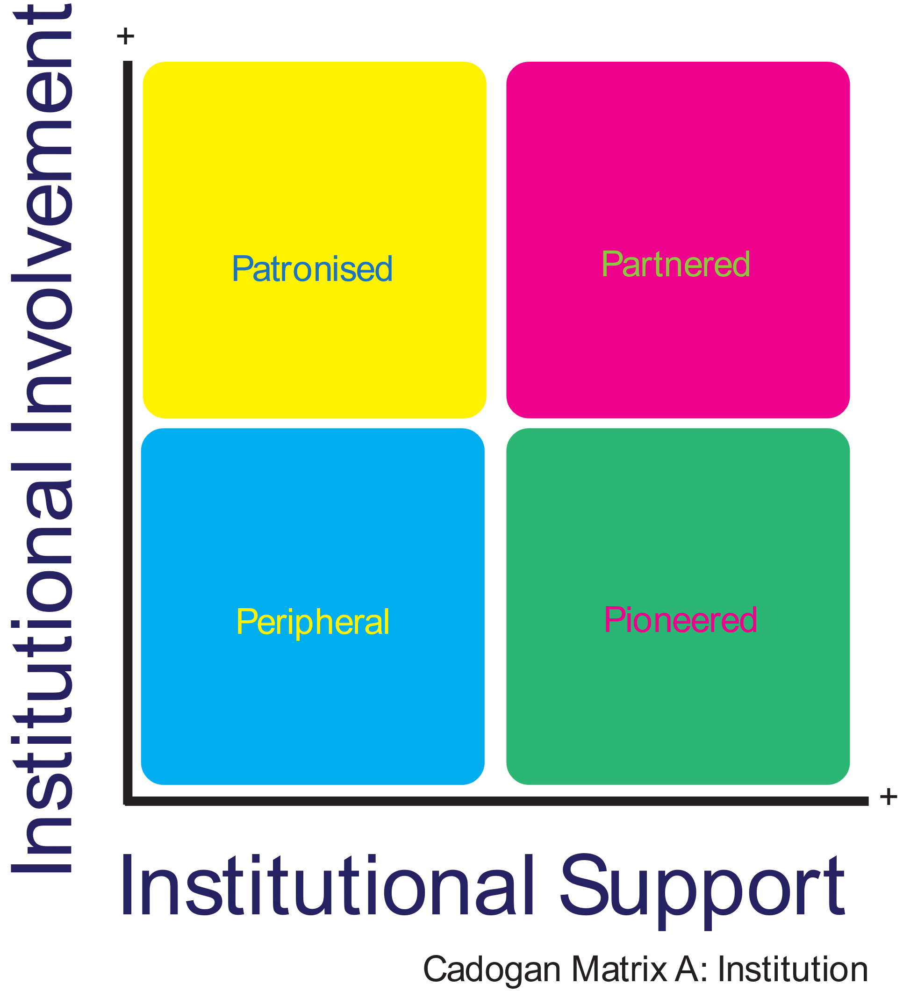
The institution holds power too…
Notes:
We often think we’ve got either a terrible or a brilliant relationship with our institution. It’s difficult to quantify, and so difficult to tackle. The Cadogan Matrix allows an SU to analyse their relationship with the institution in order to work out how to get the most out of the relationship.
On a grid with the origin set at 0 involvement and 0 support, stand first where you reckon their level of support for your SU lies, then walk up to the best representation of their involvement in your activity.

Slide 88
The meaning of the matrix
They want you to act as a passive service provider and be otherwise quiet. They have you “on the cheap”.
They want to be your best friend. They’ll forgive you some faults and trust you to help them deliver wins for the college.
They do not know. They do not care.
They won’t fund or support you. They may see you as a risk.
They probably don’t really know what you’re doing and they’re quite comfortable with that.
Notes:
We often think we’ve got either a terrible or a brilliant relationship with our institution. It’s difficult to quantify, and so difficult to tackle. The Cadogan Matrix allows an SU to analyse their relationship with the institution in order to work out how to get the most out of the relationship.
On a grid with the origin set at 0 involvement and 0 support, stand first where you reckon their level of support for your SU lies, then walk up to the best representation of their involvement in your activity.

Slide 89
Privilege
Privilege is the enhanced opportunities or easier options open to individuals or groups based on a characteristic they possess
It’s not the possessor’s fault and it doesn’t make them bad
But blindness to the possession of privilege can result in a false understanding of one’s own status
It may convince a person that the relative inequality in power is due to some flaw in other people
It may convince a person that they simply deserve things more.

Slide 90

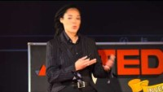
Great video on privilege
QR Code for video on YouTube
Great video in total; if short on time go to 7:35

Slide 91
Exercise: The Wheel of Fortune is also the Wheel of Misfortune.
You will be paired with the other group
You will consider the concept of privilege and how it impacts Students’ Union engagement
You will seek consensus on where people with diverse characteristics exist in a possible construct of power.
A list of three characteristics for each category will be given to you.
You will discuss amongst your new extended group where each characteristic fits in the wheel of fortune
You’ll take some time to consider your own privilege
Notes:
There will be a 1m Wheel of Misfortune for each group

Slide 92
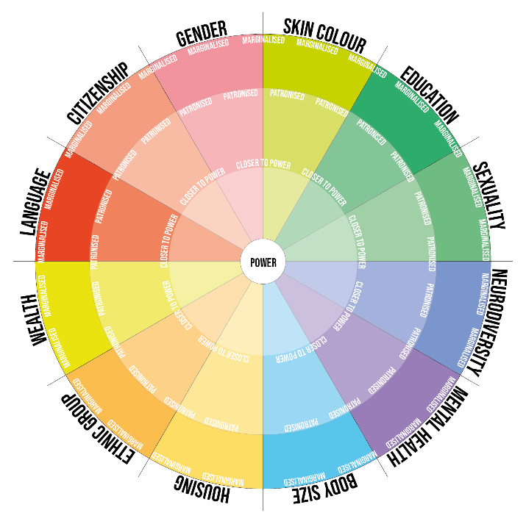
The wheel of fortune is also the wheel of misfortune.
Resource
Needed
Notes:
1m by 1m copy of this in your room.
Each segment has three spaces. Your group should consider which group in each category is closer and further away from power – or who is most marginalised, most patronised and who is closest to power.
Have someone Sharpie their final decisions onto the wheel.
Label the sheet with your Group Name.
For instance, on ‘Gender’, Your group may decide that ‘Cisgender Males’ are closest to power, then ‘Cisgender Females’ are further from power and patronised, whilst Trans or Nonbinary people are marginalised.
Explain that there could be other categories, but these are the categories which occurred to the author of the exercise, and that this is itself a result of biases, and privilege.

Slide 93
So, privilege exists. What now?
If you’ve concluded that privilege is a real thing, hopefully:
  You’ll want to ensure that your own privilege doesn’t blind you to the struggles of other people and groups
  You’ll want to address the deficit other people experience
The good news is that you also have power
  You can take steps to provide a voice and a platform to vindicate the needs of others
  You can extend equity to the students who need it most.

Slide 94

Equality and Equity
https://youtu.be/X0N22PMdF1U
Notes:
Introduce the video by telling the group that they may have seen all this before, but the video has an interesting way of combining communication about diversity and the concepts of equity and equality. You may wish to elaborate but this covers the core content.

Slide 95
Choosing Priorities
“Just because we can’t do everything doesn’t mean that we can’t do all the things we can do”
Tony Blair, Prime Minister of the United Kingdom

Slide 96
Prioritising the Work of the SU
We do lots of stuff
We sometimes continue doing stuff because ‘it’s always been done that way’
We can’t just keep loading in new activities and expect everything to get done.
We should establish priorities. We need to dump some stuff.
We need the Priority Matrices.
  It’s a lot simpler than it sounds
Notes:
Happy simplex slide. Speaks for itself.

Slide 97
Prioritisation Exercise
Resource
Needed
Take 5 post-it notes
On each one, write a thing the SU does
Now take 5 more post-its and create a copy of each thing
Hold on to them.
Your tutor will explain!
Notes:
Self explanatory slide

Slide 98
Should we do it at all?
Seriously Consider Stopping It
Consider a less expensive way of doing a similar thing, but do continue.
Reassess
Delegate
Outsource
Do more of it and prioritise it.
Resources
Needed
Value Added
Notes:
Tutor: On two flipchart pages, make a grid replicating the above. Blutack it to the wall. The group will put their postit notes onto this for a discussion on setting priorities.
Explain that we have a limited set of resources – intellectual, emotional, financial and time, and just because things have always been done is not a good guide to what ought to be done in the future. It’s time to have a spring clean of the work we do, or at lease

Slide 99
When should we do it ?
Schedule it to be done on time but… later
PRIORITY 3
Do it now
PRIORITY 1
Consider not doing it; plan to communicate as soon as practical
PRIORITY 4
Delegate it now to someone else who can do a better job with it; give them support.
PRIORITY 2
Importance
Urgency
Notes:
Explain to the group that time sensitivity is all relative – if everything on the to-do list can be knocked off easily and quickly, they should resist the temptation to do so, and instead ensure that delegation and sharing tasks with the team, particularly at the start of the term can set up a good rhythm and practices.

Slide 100

Exercise: New Student Centre!
The new President of Ballybreag TU has explained to the Governing Body that in an act of inexplicable benevolence, he has decided to replace the Portakabin Students’ Union building with a new Student Centre.
It will have two floors.
It will have a total floor space of 2,000 sqm
You get to decide what goes into it
Notes:
This is a FRIDAY MORNING session. It’s fun. Good note to end on.
Give it 40 minutes.

Slide 101
You have 2,000sqm maximum
Facility | Space | Facility | Space
Swimming Pool with Wave Machine | 600 | Sabbatical Offices | 200
Canteen | 400 | Clubs and Societies Space | 200
Study Space | 400 | Entrepreneur Space | 150
Debating Chamber | 500 | Climbing Wall | 50
Chill Space w Charging & Laptop Desks | 400 | Electronics Repair Shop | 30
Café / Bar / Deli | 300 | Sensory Suite | 40
Coffee Dock | 100 | Gym | 200
Lifts | 30 | 2 Screen Cinema | 500
Book Shop | 100 | Music & Gigs Venue | 600
Launderette | 200 | Multidenominational Prayer Space | 200
Counselling Suite | 400 | Supermarket | 700
Notes:
Put this up on screen and tell them they can do anything they want – within 2000sqm.
Note that some items have very small areas, but also note that some things will automatically exclude some others.

Slide 102
VIDEO SEND WhatsApp
+353894845657

Slide 103
Decisions, decisions…
Outline how you will make decisions
Outline any guiding principles you would require
Hand the process over to the rest of the team
Try to keep order and come to conclusions within 20 minutes
Nominate a President to feed back to the group.
Notes:
Split the group into: two uneven groups
One group of 3: retain them in the room
One group comprising the rest of the group: send them on a break
The group of 3 must establish a process for how decisions will be made
They should also make recommendations for ground rules on how the final decisions are taken
When 10 minutes of deliberation time have elapsed, bring Group B back into the room
Have someone from Group A explain the rules and the three guiding principles
Group B must comply with the rules set by Group A
There will be 20 minutes to agree the position
The group should then present.

Slide 104
What have we covered?
The role of the officer is important – the role in the team is important too.
The SU exists to secure educational and social change
Unity really is strength.
The SU officer has to have an ethical approach to leadership
Your values matter and you should be honest about them
Campaigning is not the same as ‘doing something’
Privilege is real and don’t be scared by it.
Equity is a process. Equity is what matters in SUs
You can’t do everything. Dump some stuff. Prioritise what matters.
Change comes out of meticulous planning and following through on ideas
Campaigners analyse first, plan later.
Artists ship.
The power of the collective usually trumps the power of the college
Teams are hard.
Teams are worthwhile!
You don’t have as much time as you thought.
Think like a leader, act like a team player
You need to get out and talk to students
You need to lead as well as represent.
If you don’t have all the information or resources, making good decisions is hard.
Gather power, then give it to your members

Slide 105

Can’t spell Union without U
The student movement thrives when people plan to co-operate, collaborate and conquer together.
There is a space in the union for your skills and your determination to succeed.
We couldn’t be prouder of the officers in our movement
Thank you.

