Slide 1

Managing and reporting on finances

Slide 2

On this afternoon’s show…
Basics of union finances
Planning for the whole year
Setting a plan and tracking it
Reporting and discussing finances

Slide 3

Some Jargon
Creditor: Someone who you owe money to now
Debtor: Someone who owes you money now
Liability: Something for which you will owe someone money in the future
Asset: Something which could generate money for you in future
Fixed Cost: A cost which doesn’t change much and you can’t do anything about
Variable cost: A cost which can go up or down
Deficit: You spent more than you have brought in
Surplus: You didn’t budget correctly and have more money than you expected.

Slide 4

Basics of Union Finances
Main sources of funding for SUs?
GO!

Slide 5

Where do we get our money?
Capitation Grant
Sale of Tickets for Events
Sponsorship
Sales from Shops
Sales from Services
Gifts / Bequests
Surpluses from previous years

Slide 6

Some things we can predict
Some things we can’t. Let’s do some thinking.
This Photo by Unknown Author is licensed under CC BY-SA

Slide 7

Ballgazing
List the incomes we can predict – amount and time
List the incomes we can’t predict but are likely
List the incomes we think are unlikely
Then…
List the expenditures we can predict – amount and time
List the expenditures we can’t predict but are likely
Get a crystal ball for the rest

Slide 8

If your first column doesn’t align with the second…
You have now understood the basic financial management problem

Slide 9

So let’s prepare a budget

Slide 10
Elements of a trackable budget
Incomes receivable with times
Expenditures payable with times
Balance per period

Slide 11

What is a trackable budget?
The financial resource available to you now
When more money will be available
Who you will come under pressure from for money
Who you need to put pressure on for money
When to plan to order things and spend

Slide 12
If you don’t have a book-keeper, get a spreadsheet
The spreadsheet is easy to use and doesn’t lie
Populate it with every fixed cost and guaranteed income you have
Fill it in every day – takes 5 minutes
Reconcile your Spreadsheet with your bank statement each time one comes in.
Here’s one (well, two) we made earlier

Slide 13
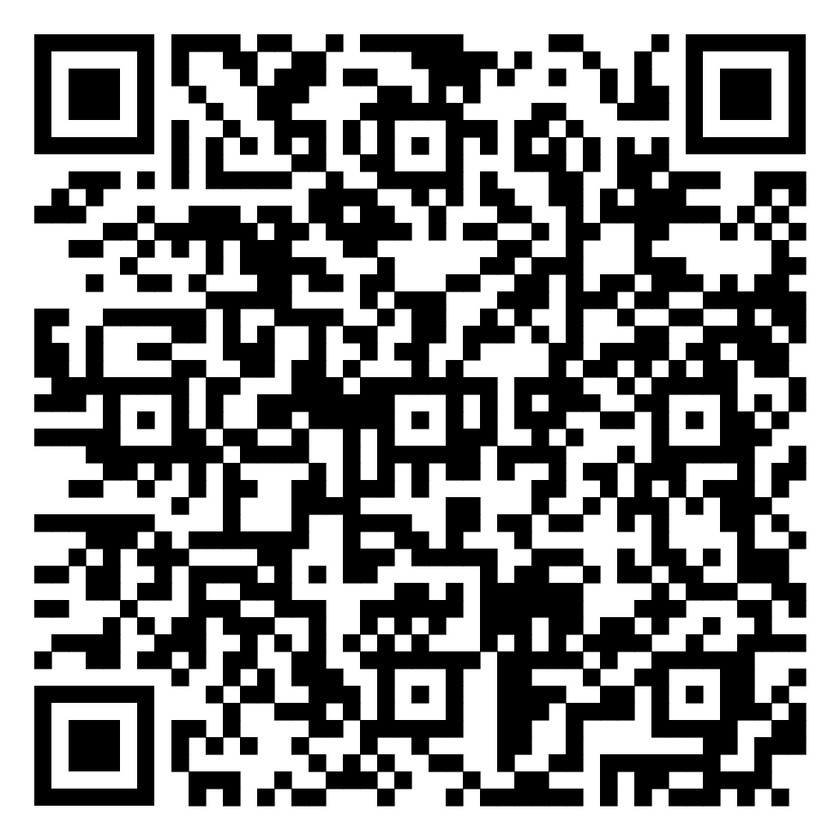
QR Code for spreadsheet

Slide 14

When things go wrong
Sometimes unexpected bad stuff can happen
It’s less likely when we plan properly
We need to either reduce our outgoings or increase our incomes

Slide 15
Rank your existing debts if funds are low, then ask yourself…
How much trouble would not paying this land us in?
How much trouble would paying this cause for our cash position?
Can we communicate with the creditor to spread or delay the payment?

Slide 16

Aviate, Navigate, Communicate
Don’t stop paying important items
Do prioritise and be prepared to go without some activities – choose carefully
Be prepared for uncomfortable conversations with creditors, who will want evidence of your position

Slide 17
Recognise that most suppliers are small companies
They have mouths to feed too
They aren’t as stable and secure as you are (believe it or not)
If they go out on a limb for you, make sure you secure their payment as soon as you possibly can

Slide 18
Never ever ever
Fail to pay your staff on time or even suggest that might happen
Agree to spend more money than you expect to have available within 28 days on anything where payment is likely to be demanded before 28 days
Take money you aren’t legitimately and explicitly entitled to.

